Slide 1
Database Applications and Information Systems
Dr. Dan Lin
Associate Professor
EECS Department

Slide 2




Slide 3
https://www.youtube.com/watch?v=6yWzKvQXsYM

Slide 4
What is a Database?
Database:
  A collection of related data.
Data:
  Known facts that can be recorded and have an implicit meaning.
Mini-world:
  Some part of the real world about which data is stored in a database.

Slide 5
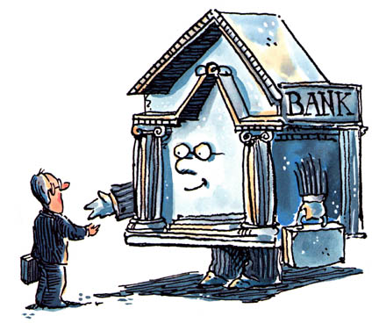







Slide 6





Databases touch all aspects of our lives
http://www.amazon.com/
https://www.facebook.com/
https://www.bankofamerica.com/
http://www.expedia.com/
http://www.realtor.com
https://blackboard.mst.edu/webapps/login/
http://www.petfinder.com/

Slide 7
What is a Database System?
Database Management System (DBMS)
  A software package/ system to facilitate the creation and maintenance of a computerized database.
  Define (data types, structures, constraints)
  Construct (storing data on some storage medium controlled by DBMS)
  Manipulate (querying, update, report generation) databases for various applications.
Database System
  The DBMS software together with the data itself. Sometimes, the applications are also included.

Slide 8

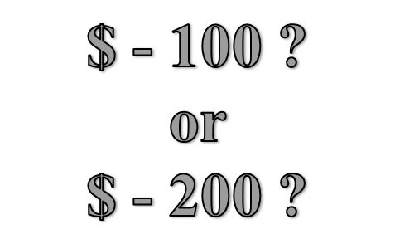
Database Systems
You and your Mom each take $100 from the same account but different ATM’s at about the same time.

Slide 9
Course Goal
Understand the foundations on which today’s work is built
  Existing database systems
Build your own database systems by the end of the semester
  Complete a 3-phase semester-long course project
Be the lead of the next generation database technology!

Slide 10
Course Information & Policies

Slide 11
Course Outline
Course Introduction
Database System Concepts
Entity-Relationship Model
Enhanced Entity-Relationship Model
Relational Data Model
Relational Algebra
6. Relational Data Model Mapping
7. SQL programming
8. Functional Dependency and Normalization
9. Indexing
10. Database triggers and security

Slide 12
Canvas
Please check our course on Canvas regularly (at least once per week), which will contain the following information:
  Course materials
  Office hours, TA contact information
  Announcements such as exam dates, homework due dates, etc.

Slide 13
Course Methodology
Lectures to present the concepts
  Unless otherwise noted, all the materials that you are expected to know will be covered in class
  Interaction (questions/discussion/thinking) encouraged
Reading will fill in the details
  Database Design, Application, Development and Administration, 3rd Edition, Michael V. Mannino, 2007
  Elmasri, R. and Navathe, S., Fundamentals of Database Systems, 6th Edition, Addison-Wesley Publishing Company
  (Free online) http://iips.icci.edu.iq/images/exam/databases-ramaz.pdf
Homework and Projects get you to understand what you’ve read and heard

Slide 14
Evaluation and Grading
Points earned as follows:
  Individual work: 4 Quizzes (8%), Midterm (20%), Final Exam (32%)
  Group work: 4 Homework (20%), Project (20%)
Late work penalized 20% per day within 48 hours of the time it is due. No credit after that.
Estimate of how final grades will be assigned
90‑100% A; 80‑89% B; 70-79% C; 60‑69% D; below 60% F.
Final grade may be curved based on the overall class performance.

Slide 15
Group
Homework and project will be completed as a group.
Find your group members. Each group should not have more than 3 members.
Please sign up your group on Canvas at least one week before the deadline of Homework 1.
  If you need any help to find a group, please let me know.

Slide 16
Important Information
ACADEMIC DISHONESTY
  Any act of cheating will result in a score of 0 for the entire assignment and repeat offences will be reported to the Office
SPECIAL NEEDS
  If you have a documented disability and anticipate needing accommodations in this course, you will need to request that the Disability Services staff send a letter to me verifying your disability.

Slide 17
Start Your Project Early to Earn Bonus Points
This course will teach only the SQL programming while a realistic database system nowadays typically has a web interface.
The web interface implementation is not required for your project, but extra 5 bonus points toward your total grade will be awarded to the successful implementation of a web interface that connected to your SQL database.

Slide 18
Web Interface
It is easy to develop a simple web interface if you start to learn it from now.
  XAMPP(MySQL+PHP) is highly recommended
  http://www.apachefriends.org/en/xampp.html
  PhP tutorials:
    http://www.w3schools.com/PHP/default.asp
    http://php.net/manual/en/index.php

Slide 19
What’s Next …
Basic concepts of database systems
  Chapter 1 and 2

